Slide 1
EY Techathon 4.0
Re-imagining possibilities with Generative AI
Detailed Submission Template

Slide 2
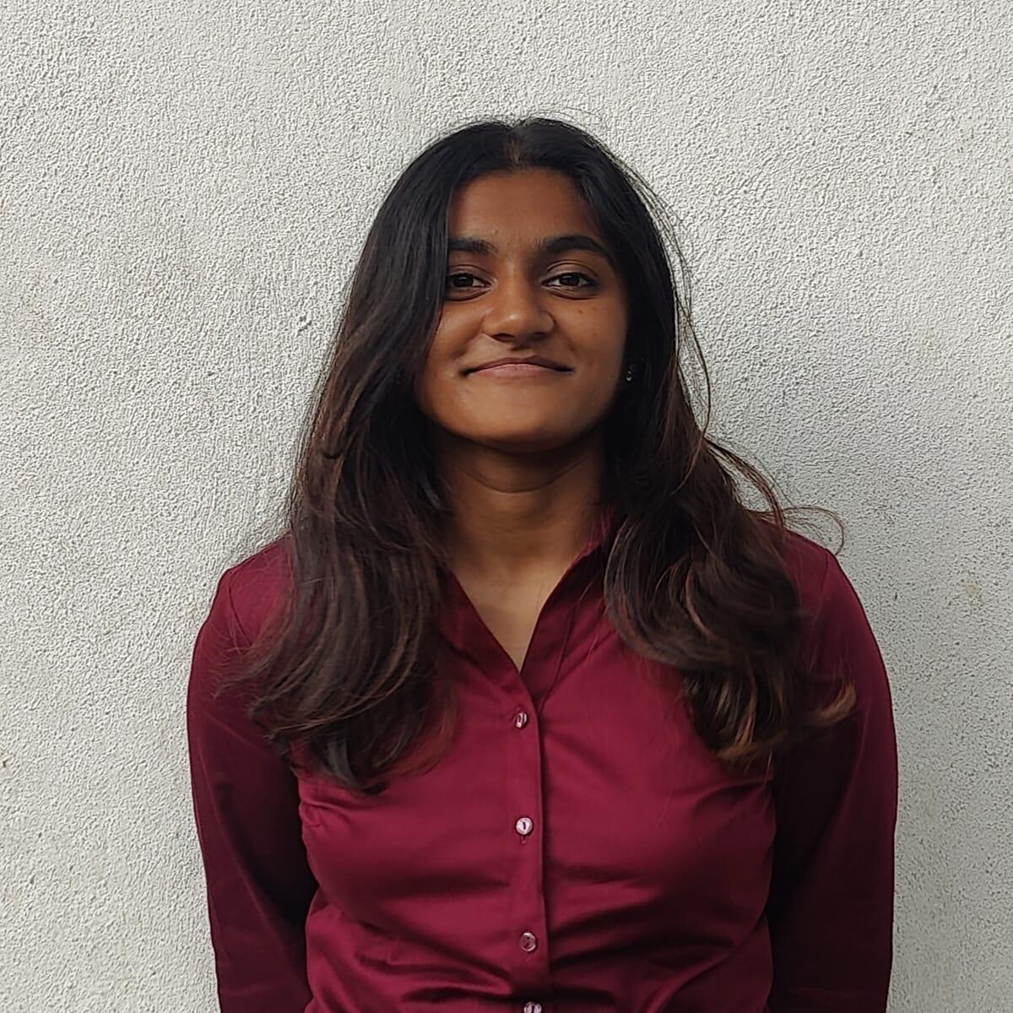
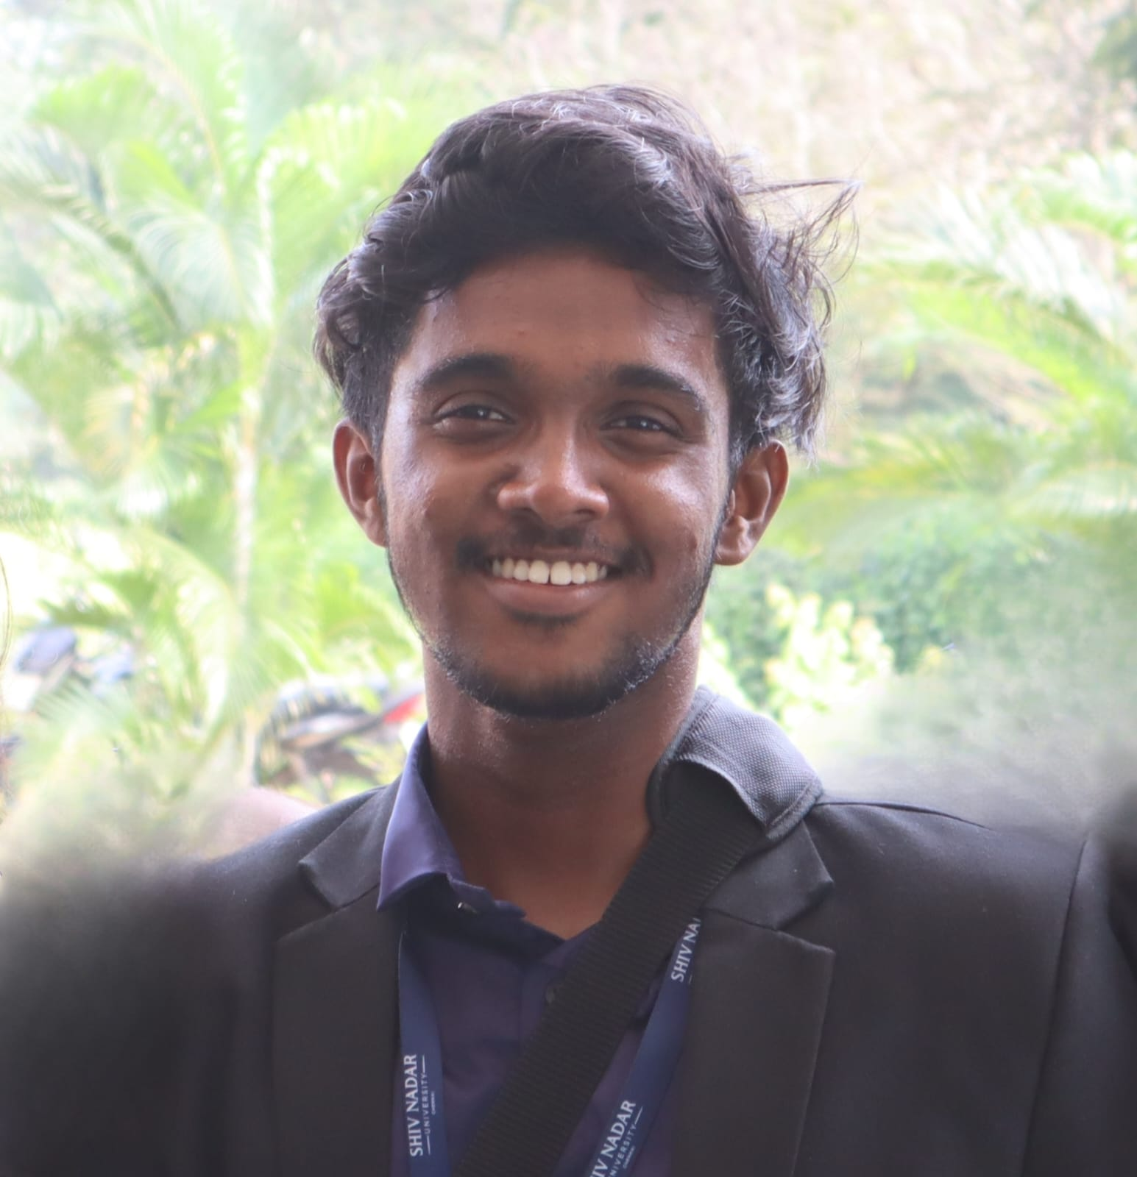
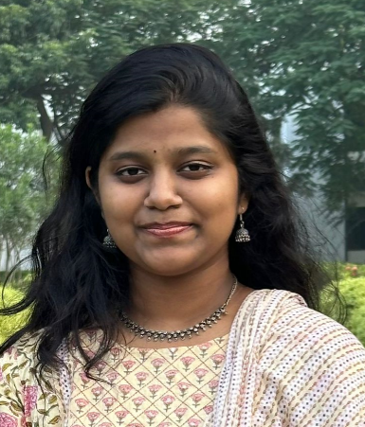
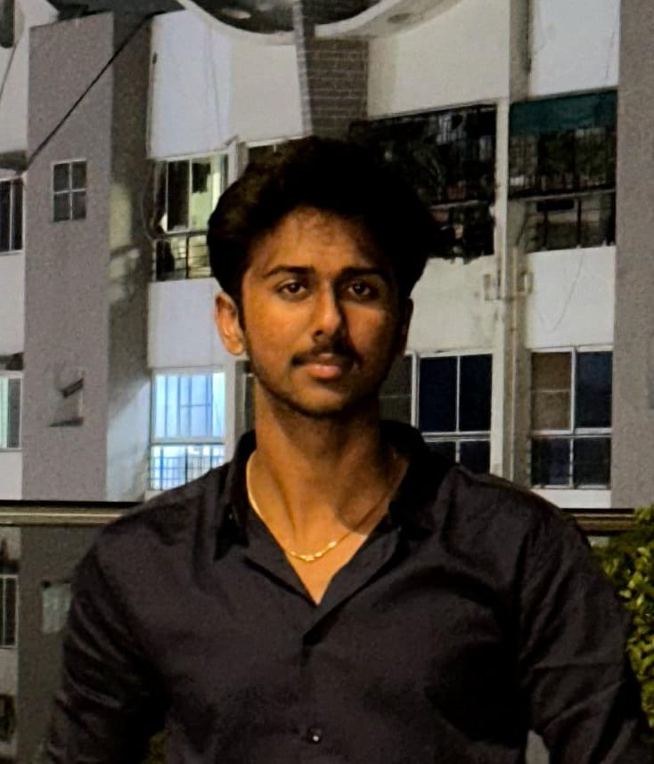

OUR TEAM
P
Team Name: Binary Nomads
Problem Statement : Enhancing Retail Experiences with Generative AI
Team Member 2 pic
Team Member 3 pic
Team Member 4 pic
Team Member 1 Name : Sansita Karthikeyan
College name : Shiv Nadar University, Chennai
Contact Detail (phone number) : 9611103839
Role in Solution Development (please specify) : Colour Theory and Product Analytics
Team Member 2 Name : Rupin Ajay
College name: Shiv Nadar University, Chennai
Contact Detail (phone number) : 8248863436
Role in Solution Development (please specify) : Dynamic Pricing, UI and Virtual Try-on
Team Member 3 Name : Akhila Rayala
College name: Shiv Nadar University, Chennai
Contact Detail (phone number) : 9100909103
Role in Solution Development (please specify) : Virtual Try-on and Colour Theory
Team Member 4 Name : Sanjay P N
College name: Shiv Nadar University, Chennai
Contact Detail (phone number) : 7093940853
Role in Solution Development (please specify) : Virtual Try-on and Product Analytics
Team Member 5 Name : Rohith Jeevanantham
College name: Shiv Nadar University, Chennai
Contact Detail (phone number) : 8248786510
Role in Solution Development (please specify) : Dynamic pricing

Slide 3

Executive Summary
Revolutionizing Retail with Cutting-Edge Technology
In the realm of virtual try-ons, OpenCV, Haar-Cascades and NumPy collaborate to ensure accurate virtual product trials using computer vision and numerical computing. Dynamic pricing, powered by Python and object-oriented programming, enables real-time adjustments for competitive positioning. This tech synergy promises a transformative retail landscape—personalized color palette recommendations driven by generative AI enhance shopping journeys, optimizing inventory and pricing dynamics for retail success.

Slide 4
Solution
Mission: Transforming Online Shopping Experience
User-Centric Design: Crafting Seamless Interfaces and a Robust Backend Solution for Fashion Retail
Immersive Shopping Vision: Redefining the Experience for All Ages in the Online Fashion Industry.
Provided Features: Virtual try-ons with users get to trail dresses using their camera
Dynamic Pricing Mastery: Real-Time Wizardry with Python and OOP for Competitive Retail
AI Color Palette Magic: Tailored Recommendations for Every Skin Tone in the Fashion Retail Sector.
Inclusive Access: Making Online Fashion an Adventure for All Ages in the Retail Landscape

Slide 5
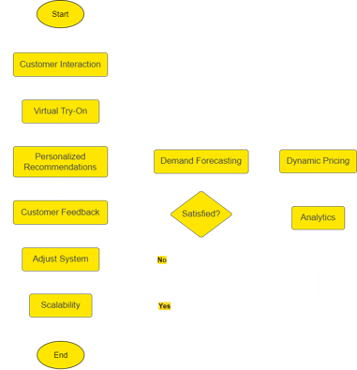
ARCHITECTURE
Effortless Inventory Management: Predict and meet customer preferences, avoiding stockouts and overstocking using AI.
Virtual Try-Ons: Elevate shopping with virtual try-ons via smartphones and computers.
Personalized Recommendations: Craft unique shopping journeys based on customer buying history.
Dynamic Pricing: Adjust prices in real-time to stay competitive and respond to market dynamics.
Optimized Inventory: Achieve the right balance to prevent shortages and excess stock.
Instant Feedback: Allow real-time customer feedback for swift improvements.

Slide 6
METHODOLOGY / APPROACH
Requirements and Goals Definition:
Collaborate with stakeholders to define inventory challenges and customer experience objectives for AI-driven solutions.
Technology Selection and Architecture:
Evaluate AI models and computer vision frameworks for predictive inventory, virtual try-ons, and personalized recommendations, designing an integrated system.
Development and Integration:
Develop and integrate predictive inventory models, virtual try-on features, recommendation engines, and dynamic pricing algorithms.
Testing and Validation:
Conduct rigorous testing to ensure accuracy, effectiveness, and seamless performance of implemented functionalities.
Deployment, Feedback, and Support:
Deploy the system, gather user feedback for iterative improvements, and provide ongoing support for optimized utilization.

Slide 7
Technological Stacks
Python (Programming Language): High-level language known for readability and versatility, used for the entire codebase.
OpenCV: Enables image/video processing, object detection, and webcam access.
NumPy: Facilitates efficient numerical computations and array manipulation. Used for efficient numerical operations, handling arrays, and computing statistics for color median.
Haar Cascades: Machine learning-based classifiers for object detection in images.
Matplotlib: Utilized for displaying images, specifically the visualization of the median color detected in the skin region.
Time Module: Handles time-related calculations and functions.
Random Module: Generates random numbers and facilitates random selections.
Object-Oriented Programming (OOP): Utilized for structuring code using classes and objects.

Slide 8
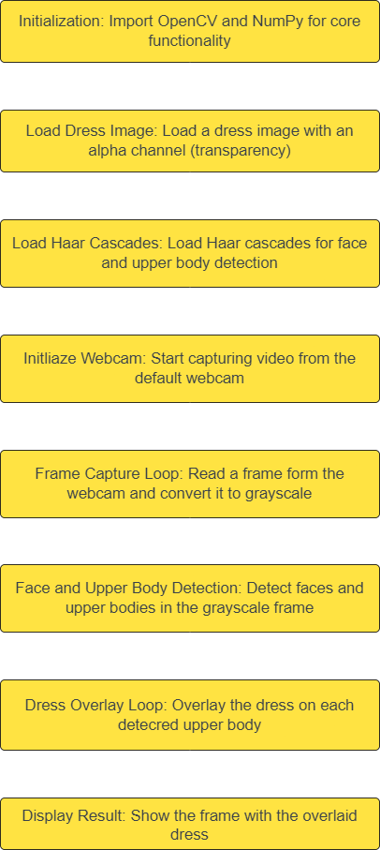
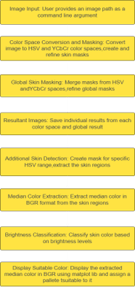
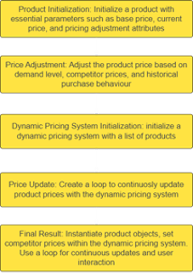
Virtual Try-on
Dynamic Pricing​
Colour Theory​
V ​ ​

Slide 9
UNIQUE SELLING POINTS
Virtual Try-On: Reduce returns with immersive try-before-you-buy.
Enhanced Customer Experience: Allow customers to virtually try on products, reducing uncertainty and making shopping more enjoyable.
Reduced Return Rates: Virtual try-ons help customers make informed decisions, minimizing the need for returns due to size or style issues.
Personalized Recommendations: Tailored shopping for happier customers.
Improved Customer Satisfaction: When customers find what they love more easily, they're happier, leading to repeat business and positive reviews.
Efficient Inventory Management: Cut costs, optimize stock, boost profits.
Increased Profitability: Efficient inventory management ensures products are available when customers want them, boosting overall profitability.
Dynamic Pricing: Stay competitive, increase revenue in real-time.
Competitive Advantage: Adjust prices in real-time based on demand and market trends to stay ahead of competitors.
Revenue Maximization: Real-time pricing adjustments can lead to increased revenue, especially during high-demand periods.

Slide 10
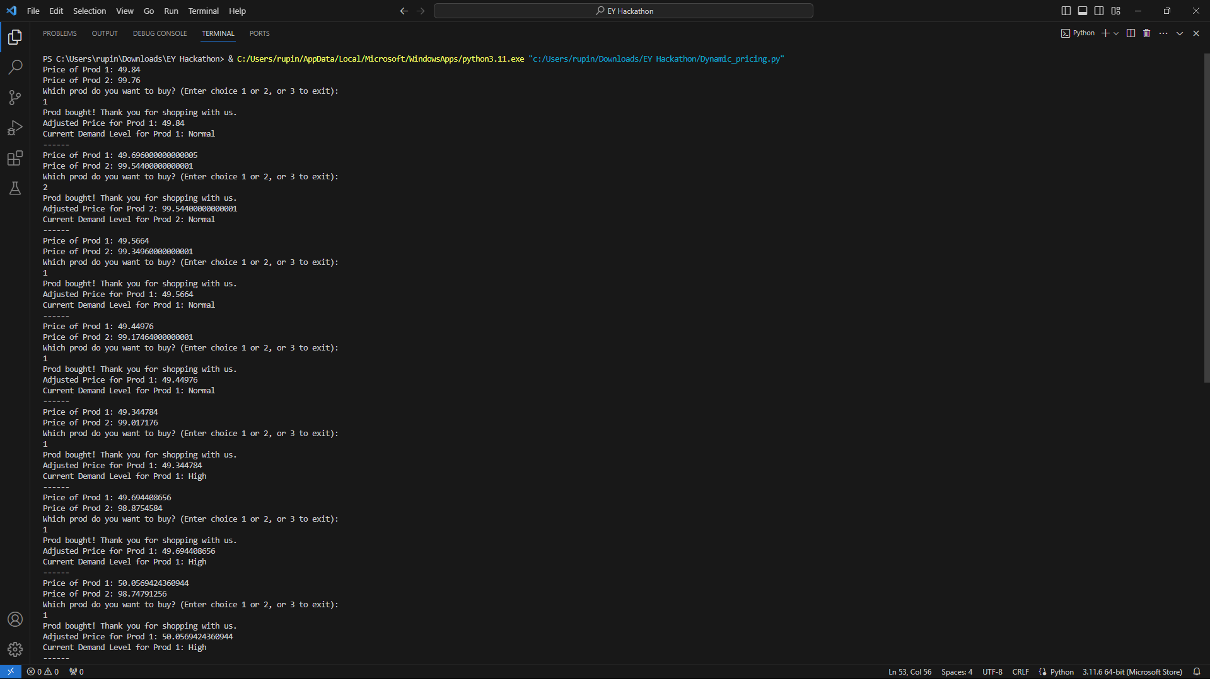
Dynamic Pricing
Dy

Slide 11
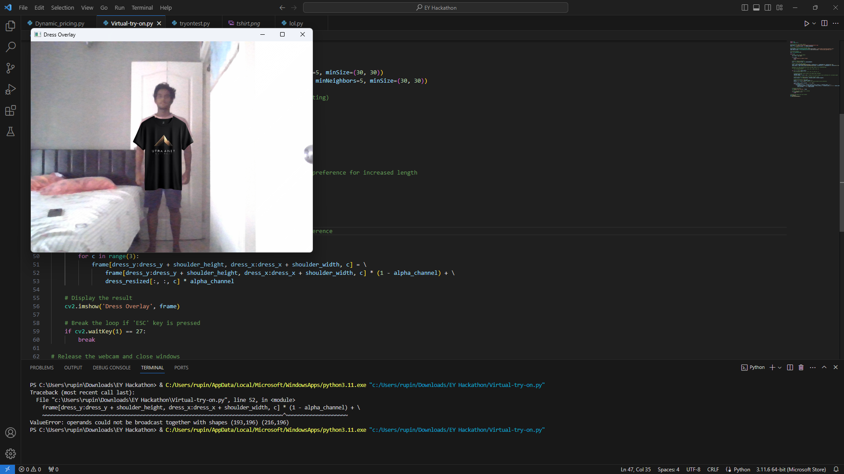
Virtual Try-on

Slide 12
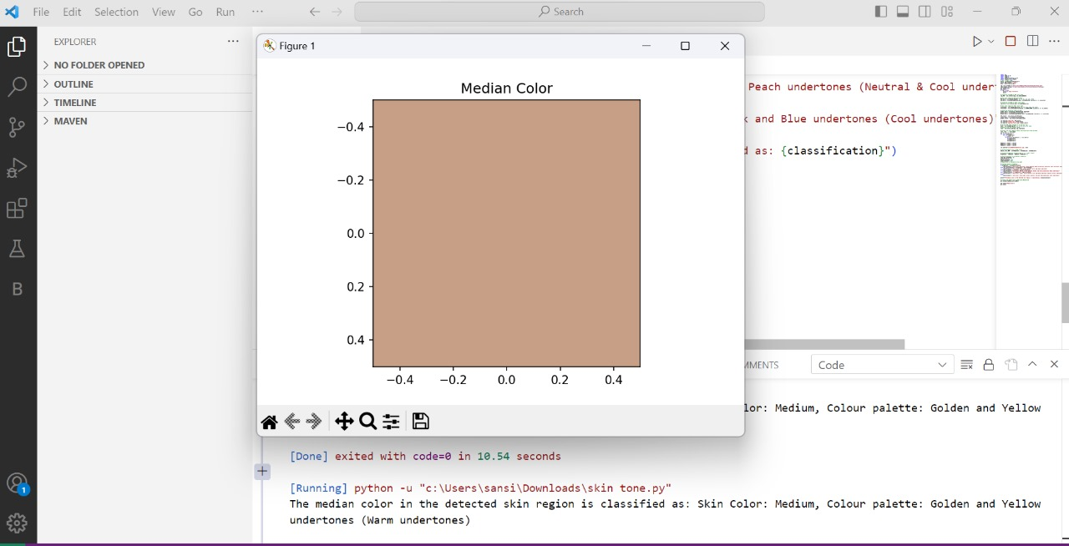
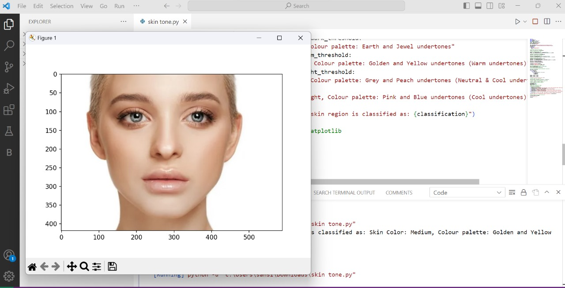
Color Theory
Working Prototype Video - FIGMA

Slide 13


Ernst & Young LLP
EY | Building a better working world
EY exists to build a better working world, helping to create long-term value for clients, people and society and build trust in the capital markets.
Enabled by data and technology, diverse EY teams in over 150 countries provide trust through assurance and help clients grow, transform and operate.
Working across assurance, consulting, law, strategy, tax and transactions, EY teams ask better questions to find new answers for the complex issues facing our world today.
EY refers to the global organization, and may refer to one or more, of the member firms of Ernst & Young Global Limited, each of which is a separate legal entity. Ernst & Young Global Limited, a UK company limited by guarantee, does not provide services to clients. Information about how EY collects and uses personal data and a description of the rights individuals have under data protection legislation are available via ey.com/privacy. EYG member firms do not practice law where prohibited by local laws. For more information about our organization, please visit ey.com.
Building a better working world
Ernst & Young LLP is one of the Indian client serving member firms of EYGM Limited. For more information about our organization, please visit www.ey.com/en_in.
Ernst & Young LLP is a Limited Liability Partnership, registered under the Limited Liability Partnership Act, 2008 in India, having its registered office at Ground Floor, Plot No. 67, Institutional Area, Sector - 44, Gurugram - 122 003, Haryana, India.
© 2023 Ernst & Young LLP. Published in India. All Rights Reserved.
This publication contains information in summary form and is therefore intended for general guidance only. It is not intended to be a substitute for detailed research or the exercise of professional judgment. Neither EYGM Limited nor any other member of the global Ernst & Young organization can accept any responsibility for loss occasioned to any person acting or refraining from action as a result of any material in this publication. On any specific matter, reference should be made to the appropriate advisor.

